Slide 1






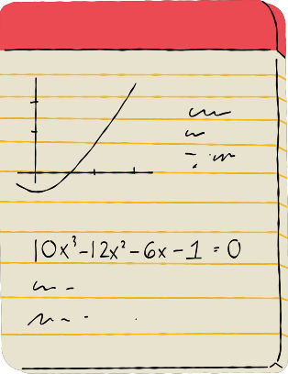





Maths
at
Kings Furlong Infant School and Nursery
1

Slide 2
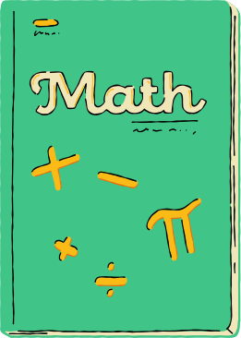
Aims of Mathematics at Kings Furlong Infants
Our curriculum ensures that all children:
Become fluent in the fundamentals of mathematics in order to develop conceptual understanding and the ability to recall and apply their knowledge rapidly and accurately.
Reason mathematically by following a line of enquiry, conjecturing relationships and generalisations, and developing an argument, justification or proof using mathematical language.
Can solve problems by applying their mathematics to a variety of routine and non-routine problems.
2

Slide 3
How is Mathematics taught at Kings Furlong Infants?
EYFS
Nursery and Reception
KS1
Year 1 and 2
In Nursery the children concentrate on numbers 1 -10.
Look at a number a week and the number is explored every day through concrete resources and rhymes
As the year progresses they will use numbers in different contexts
Specific activities linked to number of the week in provision.
Year R follow Busy Ants scheme with short inputs, small adult-led group work focusing on practical representation with some worksheets and adult-initiated activities in the provision
Revisit and Review
Main Teaching Input with opportunities to practise
Assessment from adults
Independent practise using workbook
Reasoning and Problem Solving practise
Plenary
3

Slide 4


EYFS Framework: Maths
Number
Numerical Patterns
• Have a deep understanding of numbers to 10, including the composition of each number.
• Subitise (recognise quantities without counting) up to 5.
• Automatically recall (without reference to rhymes, counting or other aids) number bonds up to 5 (including subtraction facts) and some number bonds to 10, including double facts.
• Verbally count beyond 20, recognising the pattern of the counting system.
• Compare quantities up to 10 in different contexts, recognising when one quantity is greater than, less than or the same as the other quantity.
• Explore and represent patterns within numbers up to 10, including evens and odds, double facts and how quantities can be distributed equally.
4

Slide 5









Year 1 National Curriculum
Number and Place Value
Addition and Subtraction
• count to and across 100, forwards and backwards, beginning with 0 or 1, or from any given number
• count, read and write numbers to 100 in numerals; count in multiples of 2s, 5s and 10s
• given a number, identify 1 more and 1 less
• identify and represent numbers using objects and pictorial representations including the number line, and use the language of: equal to, more than, less than (fewer), most, least
• read and write numbers from 1 to 20 in numerals and words
• read, write and interpret mathematical statements involving addition (+), subtraction (−) and equals (=) signs
• represent and use number bonds and related subtraction facts within 20
• add and subtract one-digit and two-digit numbers to 20, including 0
• solve one-step problems that involve addition and subtraction, using concrete objects and pictorial representations, and missing number problems such as 7 = ? − 9
5

Slide 6
Year 1 National Curriculum
Multiplication and Division
Geometry - Shapes
• solve one-step problems involving multiplication and division, by calculating the answer using concrete objects, pictorial representations and arrays with the support of the teacher
• recognise and name common 2-D and 3-D shapes, including:
• 2-D shapes [for example, rectangles (including squares), circles and triangles]
• 3-D shapes [for example, cuboids (including cubes), pyramids and spheres]
Fractions
Geometry - Position and Direction
• recognise, find and name a half as 1 of 2 equal parts of an object, shape or quantity
recognise, find and name a quarter as 1 of 4 equal parts of an object, shape or quantity
• describe position, direction and movement, including whole, half, quarter and three-quarter turns
6

Slide 7
Year 1 National Curriculum
Measurement
compare, describe and solve practical problems for:
lengths and heights [for example, long/short, longer/shorter, tall/short, double/half]
mass/weight [for example, heavy/light, heavier than, lighter than]
capacity and volume [for example, full/empty, more than, less than, half, half full, quarter]
time [for example, quicker, slower, earlier, later]
measure and begin to record the following:
lengths and heights
mass/weight
capacity and volume
time (hours, minutes, seconds)
recognise and know the value of different denominations of coins and notes
sequence events in chronological order using language [for example, before and after, next, first, today, yesterday, tomorrow, morning, afternoon and evening]
recognise and use language relating to dates, including days of the week, weeks, months and years
tell the time to the hour and half past the hour and draw the hands on a clock face to show these times
7

Slide 8


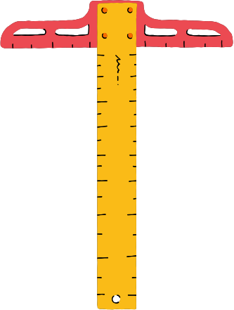

Year 2 National Curriculum
Number and Place Value
Addition and Subtraction
• count in steps of 2, 3, and 5 from 0, and in 10s from any number, forward and backward
• recognise the place value of each digit in a two-digit number (10s, 1s)
•identify, represent and estimate numbers using different representations, including the number line
• compare and order numbers from 0 up to 100; use <, > and = signs
• read and write numbers to at least 100 in numerals and in words
• use place value and number facts to solve problems
• solve problems with addition and subtraction:
using concrete objects and pictorial representations, including those involving numbers, quantities and measures
applying their increasing knowledge of mental and written methods
• recall and use addition and subtraction facts to 20 fluently, and derive and use related facts up to 100
• add and subtract numbers using concrete objects, pictorial representations, and mentally, including:
a two-digit number and 1s
a two-digit number and 10s
2 two-digit numbers
adding 3 one-digit numbers
• show that addition of 2 numbers can be done in any order (commutative) and subtraction of 1 number from another cannot
• recognise and use the inverse relationship between addition and subtraction and use this to check calculations and solve missing number problems
8

Slide 9
Year 2 National Curriculum
Multiplication and Division
Geometry - Shapes
• recall and use multiplication and division facts for the 2, 5 and 10 multiplication tables, including recognising odd and even numbers
• calculate mathematical statements for multiplication and division within the multiplication tables and write them using the multiplication (×), division (÷) and equals (=) signs
• show that multiplication of 2 numbers can be done in any order (commutative) and division of 1 number by another cannot
• solve problems involving multiplication and division, using materials, arrays, repeated addition, mental methods, and multiplication and division facts, including problems in contexts
• identify and describe the properties of 2-D shapes, including the number of sides, and line symmetry in a vertical line
• identify and describe the properties of 3-D shapes, including the number of edges, vertices and faces
• identify 2-D shapes on the surface of 3-D shapes, [for example, a circle on a cylinder and a triangle on a pyramid]
• compare and sort common 2-D and 3-D shapes and everyday objects
Geometry - Position and Direction
•order and arrange combinations of mathematical objects in patterns and sequences
• use mathematical vocabulary to describe position, direction and movement, including movement in a straight line and distinguishing between rotation as a turn and in terms of right angles for quarter, half and three-quarter turns (clockwise and anti-clockwise)
9

Slide 10
Year 2 National Curriculum
Measurement
Fractions
• choose and use appropriate standard units to estimate and measure length/height in any direction (m/cm); mass (kg/g); temperature (°C); capacity (litres/ml) to the nearest appropriate unit, using rulers, scales, thermometers and measuring vessels
• compare and order lengths, mass, volume/capacity and record the results using >, < and =
• recognise and use symbols for pounds (£) and pence (p); combine amounts to make a particular value
• find different combinations of coins that equal the same amounts of money
• solve simple problems in a practical context involving addition and subtraction of money of the same unit, including giving change
• compare and sequence intervals of time
• tell and write the time to five minutes, including quarter past/to the hour and draw the hands on a clock face to show these times
• know the number of minutes in an hour and the number of hours in a day
• recognise, find, name and write fractions ½, ⅓ and ¼ of a length, shape, set of objects or quantity
• write simple fractions, for example of 6 = 3 and recognise the equivalence of ½ and 2/4
10

Slide 11
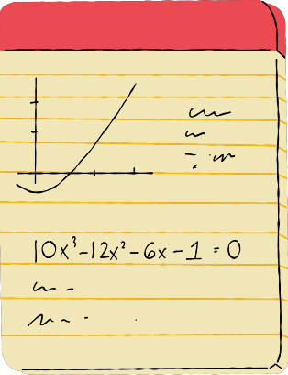
CPA Approach
C - Concrete - The ‘doing’ stage of the CPA learning approach.
P - Pictorial - The ‘seeing’ stage of the CPA learning approach.
A - Abstract - The ‘symbolic’ stage of the CPA learning approach.
11
Notes:
The concrete pictorial abstract (CPA) approach is a widely used method to teach mathematics that begins with real-world objects and ends with abstract concepts. By starting with concrete objects and gradually moving towards abstract concepts, students develop a strong understanding of the underlying concepts of mathematics. This helps to build a solid foundation for future learning and problem-solving.
C - Concrete - In the “doing” stage of the CPA learning approach, learners model problems by using concrete objects. These could be real-life resources or physical objects. Children need to physically handle these resources to begin to gain mathematics mastery.
P - Pictorial - In the ‘seeing’ stage, learners use pictorial models to represent mathematical problems. Pictorial models help students visualize mathematical concepts without the use of physical objects and encourages learners to make a direct connection between the concrete object they just dealt with and the visual representation, models or diagrams that represent the problem.
A - Abstract - In the symbolic stage, learners are introduced to the abstract concept e.g. symbols and digits and numbers. It is imperative that the learners have a solid conceptual understanding of the concrete and pictorial phases of the problem to truly understand the abstract.
It is most effective in the reinforcement and understanding of the maths concepts when it is used throughout primary school and when learners learning takes place can frequently go back and forth between the three steps .

Slide 12
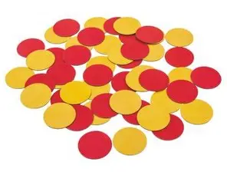
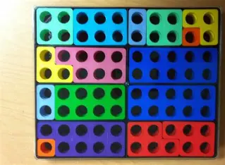
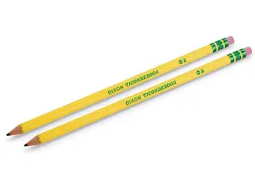
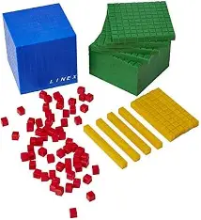
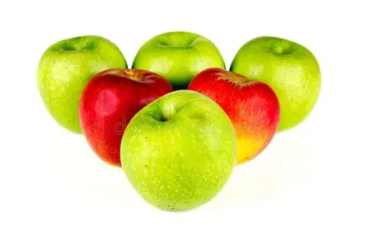
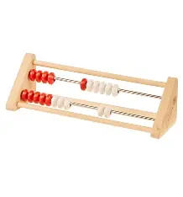
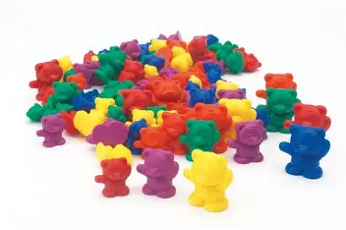
Concrete - the doing stage
12

Slide 13
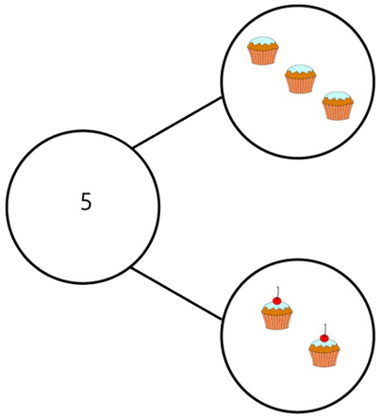
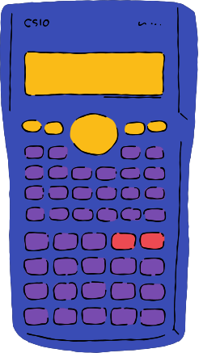
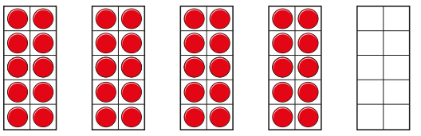
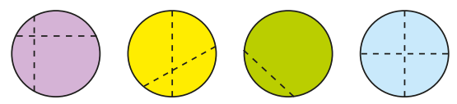
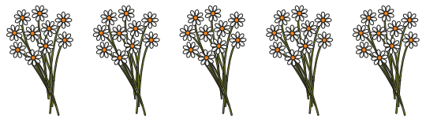

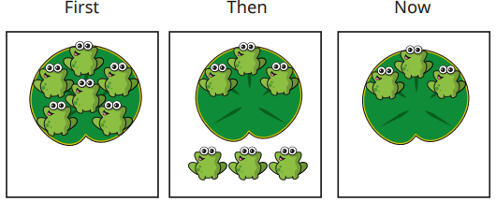

Pictorial - the seeing stage
13
Notes:
Add dienes and whiteboard of drawings

Slide 14
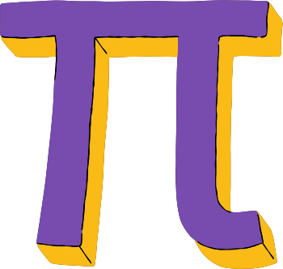
Abstract - the symbolic stage
6 + 4 = 10
4 + 6 = 10
10 = 4 + 6
7 + ___ = 10
½ of 8 = 4
¼ of 8 = 2
14

Slide 15







Can you order these numbers
from 1 - 7?
15

Slide 16

Can you order these numbers
from 1 - 7?
16

Slide 17
Can you use the practical resources on the table to represent and answer these calculations ?
15 + 42
8 + 2
4 lots of 5
4
7
½ of 16
18 + 2
17
Notes:
Practical resources
numicon
dienes
counters
pasta
cars
lego bricks

Slide 18
How could we represent the same calculations pictorially?
8 + 2
15 + 42
4 lots of 5
4
7
½ of 16
18 + 2
18
Notes:
Practical resources
numicon
dienes
counters
pasta
cars
lego bricks

Slide 19

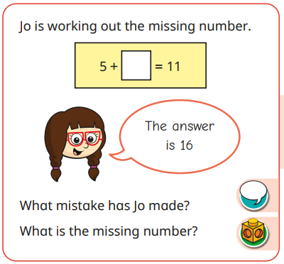
Reasoning
Explain how you know...?
Which is the odd one out?
Why?
True or False?
What do you see?
What do you notice?
What mistake was made?
What is the same?
What is different?
19

Slide 20
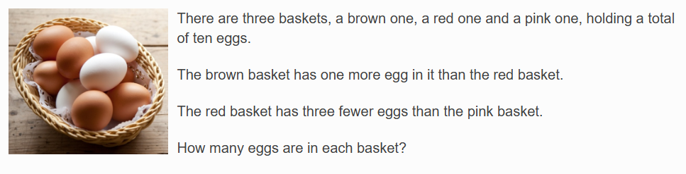
Problem Solving
Using the concrete, pictorial and abstract approach.
Can you represent and find solutions for the problem?
20

Slide 21

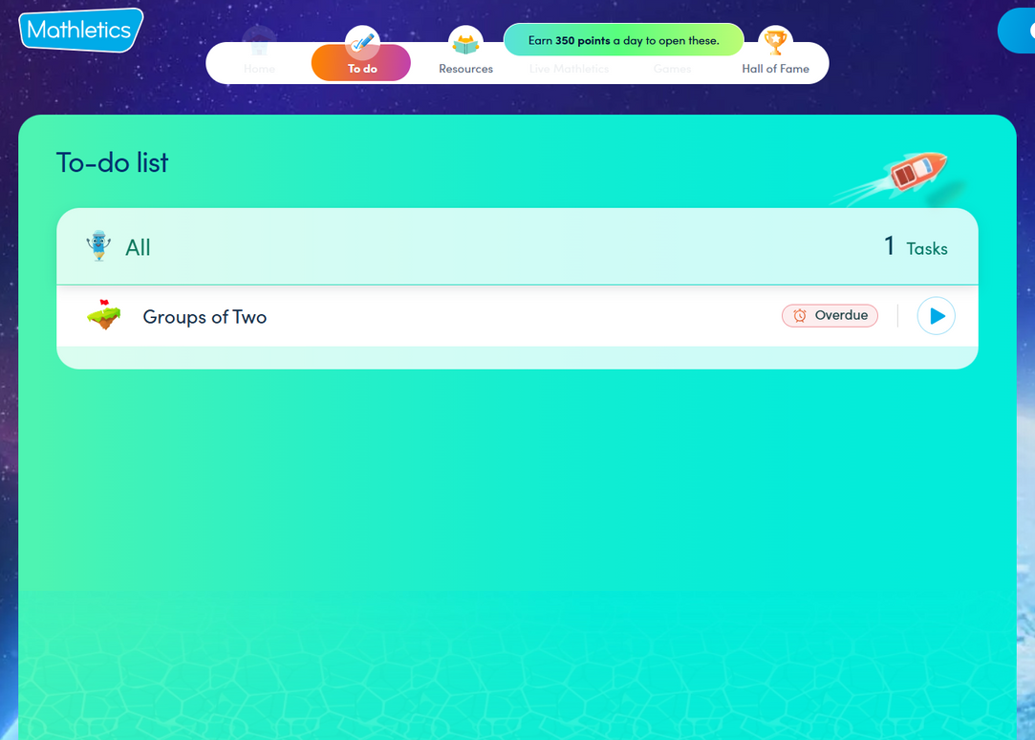
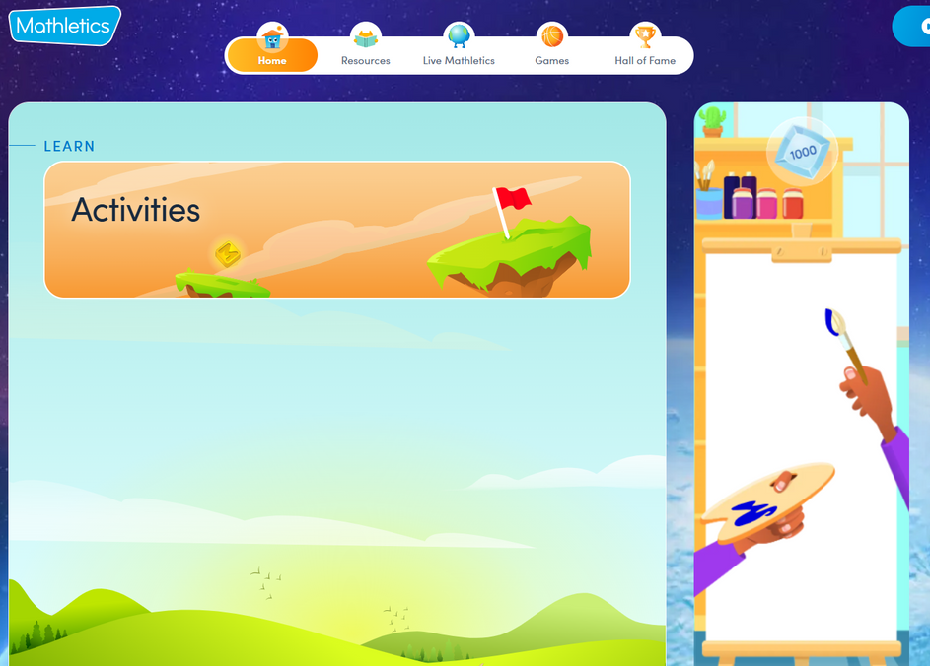
Mathletics
21

Slide 22

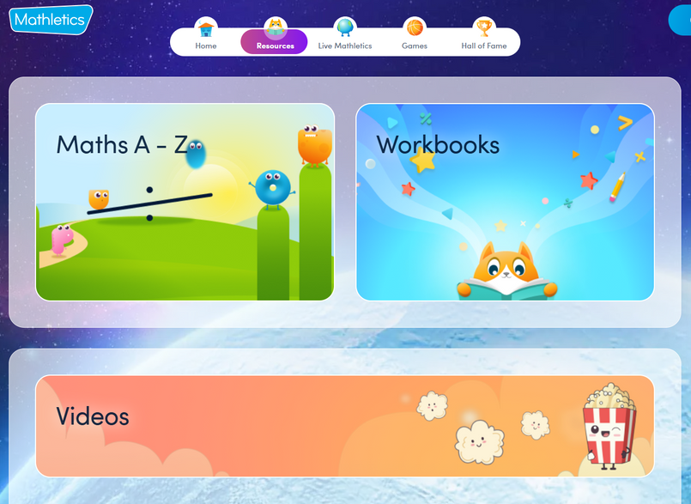

Mathletics
22

Slide 23
How can you help at home?
Be positive about maths
Engage in everyday maths - discuss maths wherever possible
Play games involving maths
Make mistakes
Learn together - we are all learners
Let your children win
Celebrate effort and strategies
Understand that there is more than one way
Don’t expect them to get it the first time or in a different context
Show the same concepts in different contexts
23

Slide 24
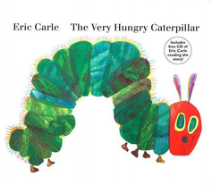



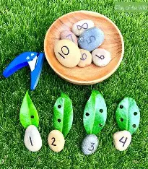
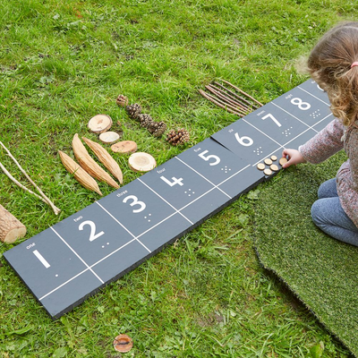
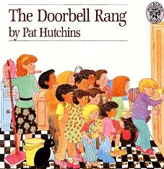
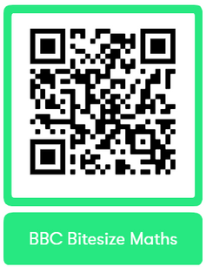

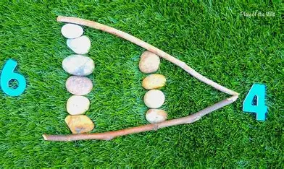
How can you help at home?
Everyday Maths
Games
Follow a recipe - a great opportunity for maths talk, estimation, weight, time, halving or doubling quantities
Create a daily/weekly timetable - use pictures alongside analogue/digital clocks and words to match. A great opportunity to understand time passing and interval of time throughout a day
Shopping - An important opportunity to handle coins and notes, discuss the value, add amounts together, subitise amounts, subtract to find change, halve and quarter amounts
Discuss the weather forecast - create charts across a set amount of time, read numbers on thermometers, discuss whether the temperature is higher or lower than the previous day.
Snakes and Ladders
Dice Games
Find numbers in newspapers and magazines
Bingo
Guess my shape
How long does it take to....?
Number of the week
Shape of the week
Hopscotch and Skittles
Count, count, count!
Books
Maths Outside
24

Slide 25
Any Questions?
25

